Slide 1

Basic Intensity transformations
Log , Power law , Power law (Gamma)Transformations
By-Neha Dattatray Dawale
Roll No-6

Slide 2
Contents
1. Introduction
Spatial domain
frequency domain
Spatial domain processes
3. Intensity Transformation Basics Example-
Contrast stretching function, Thresholding function
4.Image Transformations – Basics
Spatial filtering
Point processing
5. Some Basic intensity transformation functions
Liner(negative and identity transformations)(practical)
Logarithmic(log and inverse-log transformations)
Power-law(nth power and nth root transformations)

Slide 3
Introduction
Image Enhancement is the process of manipulating an image so that the result is more suitable than the original for a specific application.
Image Enhancement can be done in:
I) Spatial domain-:
spatial domain techniques operate directly on the pixels of an image.
II) frequency domain-:
the processing techniques are based on modifying the fourier transform of an image.

Slide 4
Spatial domain processes:
g(x ,y) =T[f(x , y)]
Input image
Processed(output)image
Operator T defined on some neighborhood of f(x, y)
g(x ,y)
Apply T
f(x ,y)
Image after processing
Original image
The spatial domain processes can be denoted by the expression
g(x, y) = T[ f(x, y)]

Slide 5
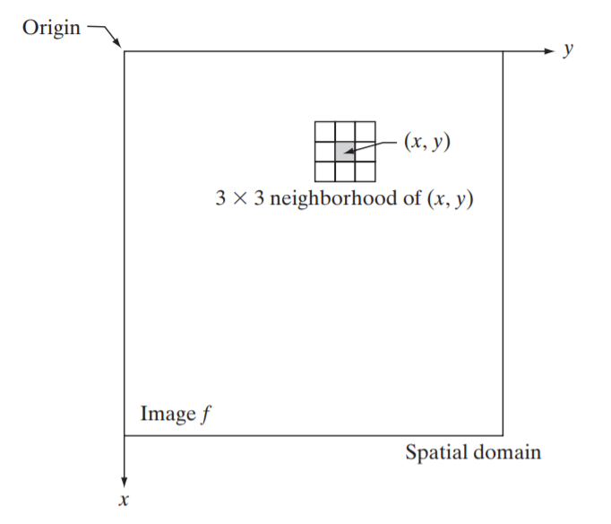
Image Transformations – Basics
The operator can apply to a single image or to a set of images
The point (x, y) shown in a arbitrary point in the image
the region containing the point is a neighborhood of (x y)
Typically the neighborhood is rectangular , centered on (x , y)
And is much smaller than the image
Spatial filtering
Generally involves operations over the entire image
Operations take place involving pixels within a neighborhood of a point of interest(x , y)
Also involves a predefined operation called spatial filter
Spatial filter is also commonly referred to as:
Spatial mask , kernel , template , window.

Slide 6
Point processing
The smallest neighborhood of a pixel is 1*1 in size
Here , g depends only on the value of f at a single point (x, y)
T becomes an intensity transformation (also called gray-level or mapping) function of the form
g(x, y)=T[f(x, y)]
s r
s=T(r)
where, s and r are variables denoting the intensity of g and f at any point (x, y) respectively.

Slide 7
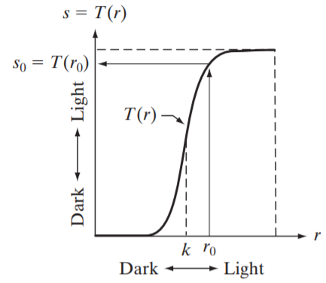
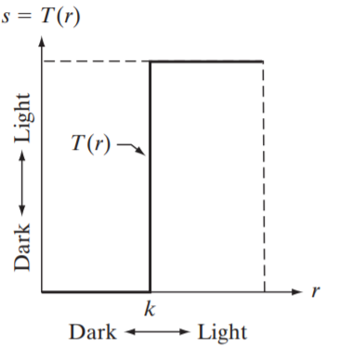
Intensity Transformation-
Contrast stretching function, Thresholding function

Slide 8
Some Basic intensity transformation functions
Here T is a transformation that maps a pixel value r into a pixel value s
since we are concerned with digital data, the transformation can generally be implemented with a simple lookup table
Three basic types of transformations
Liner(negative and identity transformations)
Logarithmic(log and inverse-log transformations)
Power-law(nth power and nth root transformations)

Slide 9
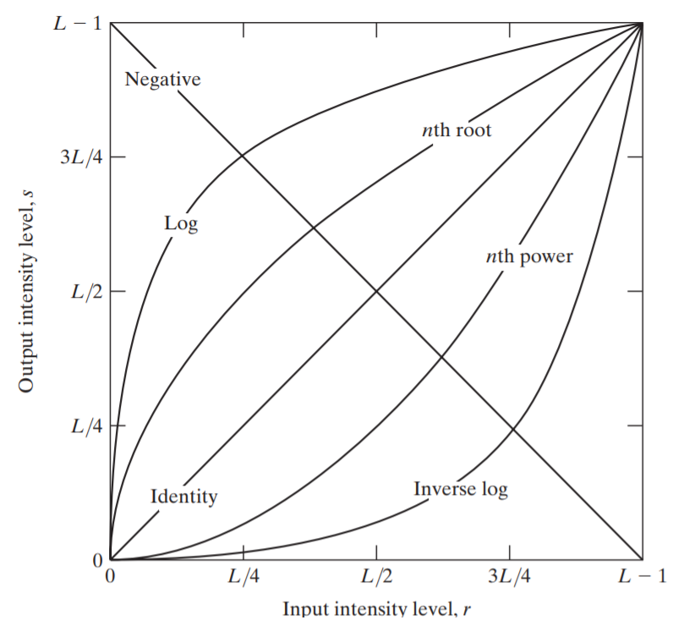
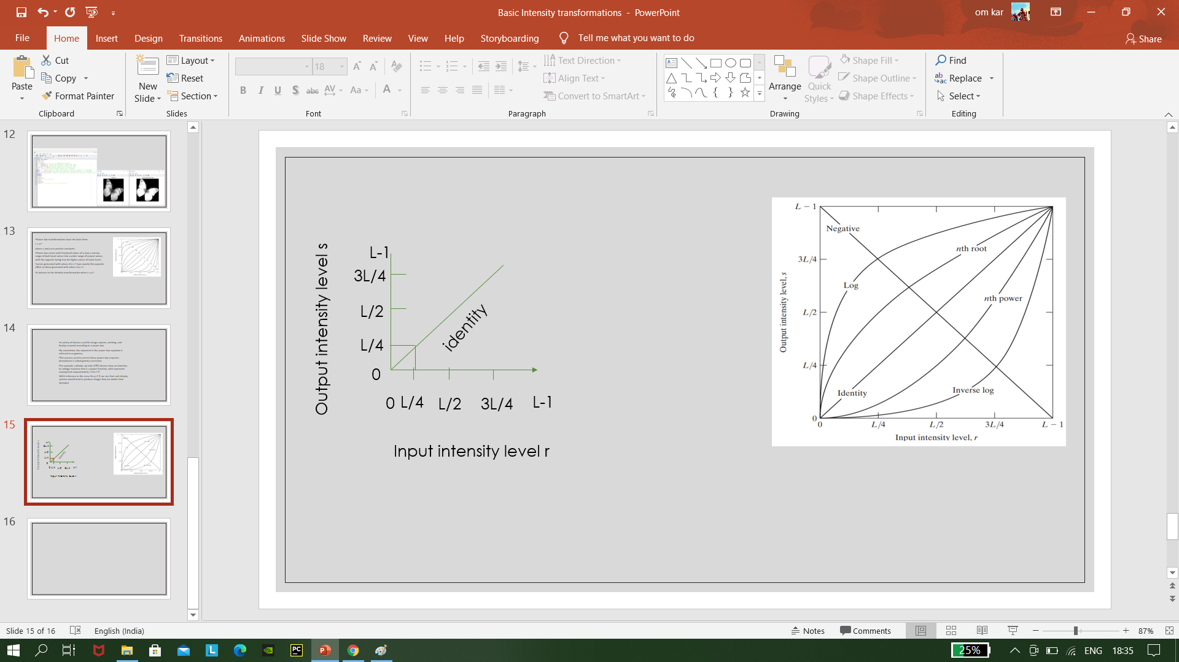
Liner transformation
Image identity: output image same as input image
For example-:

Slide 10
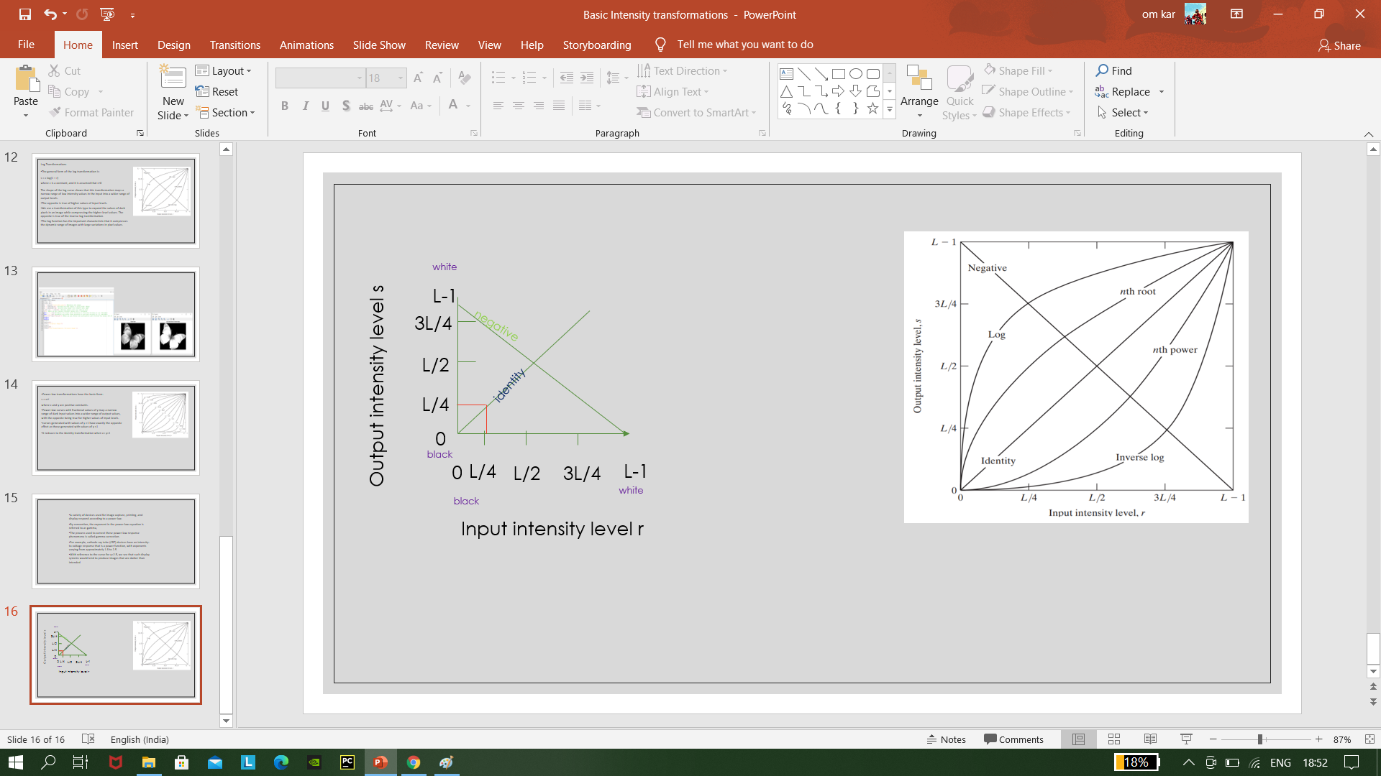
Image negative-:
The negative of an image with intensity levels in the range is obtained by using the negative transformation which is given by the expression-
s = L - 1 – r
Reversing the intensity levels of an image in this manner produces the equivalent of a photographic negative.

Slide 11
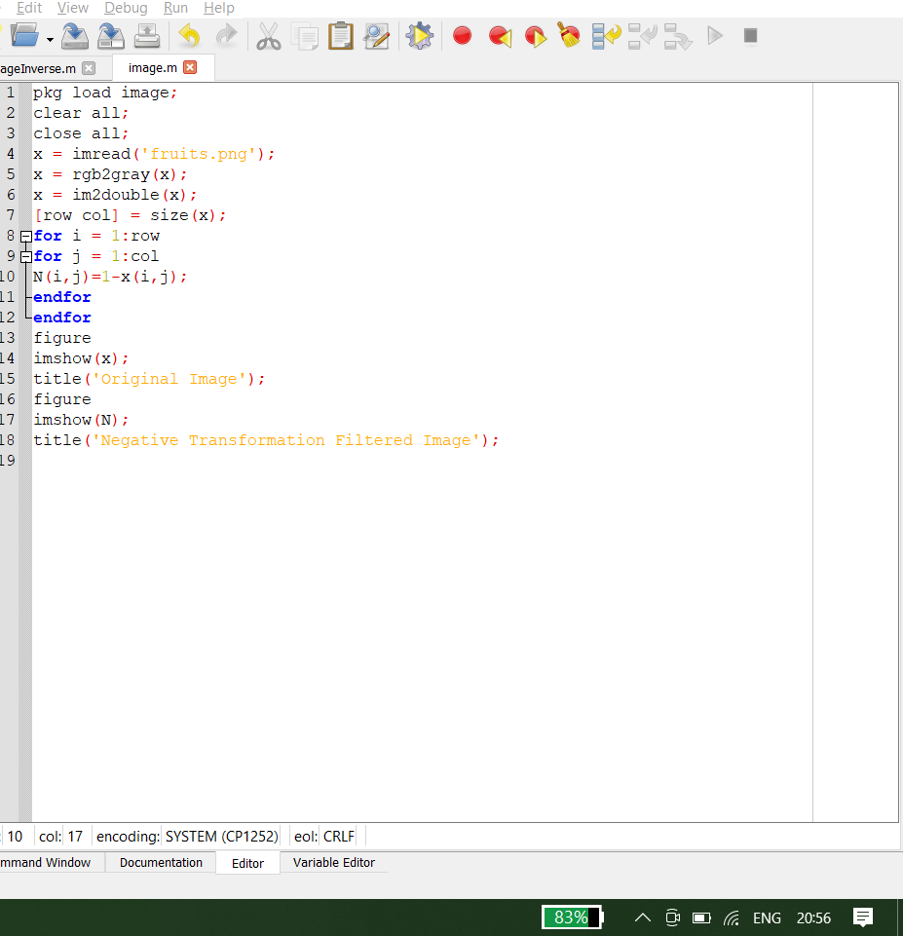

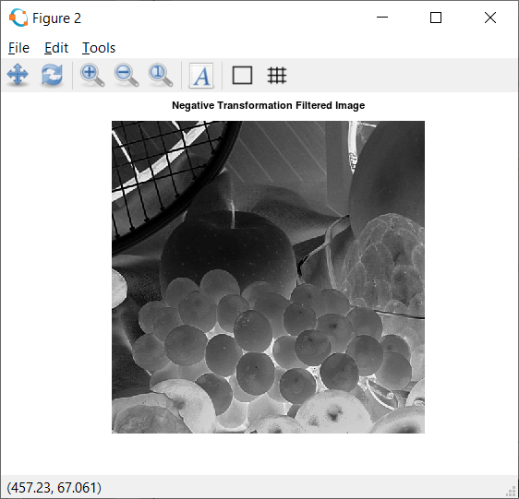
The negative of an image with intensity levels in the range[0,L-1] is obtained by using the negative transformation: s=L-1-r
Image( r )
Image(s)after applying T(negative)
Code
Application-:
image negative are used mainly in medical images and to produce slides of screen.it also used for enhancing white or black gray details embedded in dark region.

Slide 12
Image negative Example
Solution:
Step 1:
Find maximum number
Is given table 255
So, 2⁸⁼²⁵⁶
^{Step 2:}
^{S=L-1-r}
^{256-1-r =255-r}
^{Step 3:}
^{each pixels sub by 255}
how to find image negative
Formula: L-1-r
L-1=Maximum pixel value.
r=pixel value of an image.
Image (r)
Image (s)
200 | 100 | 255
160 | 150 | 60
10 | 20 | 80
55 | 100 | 0
95 | 105 | 195
245 | 235 | 175
Original image

Slide 13
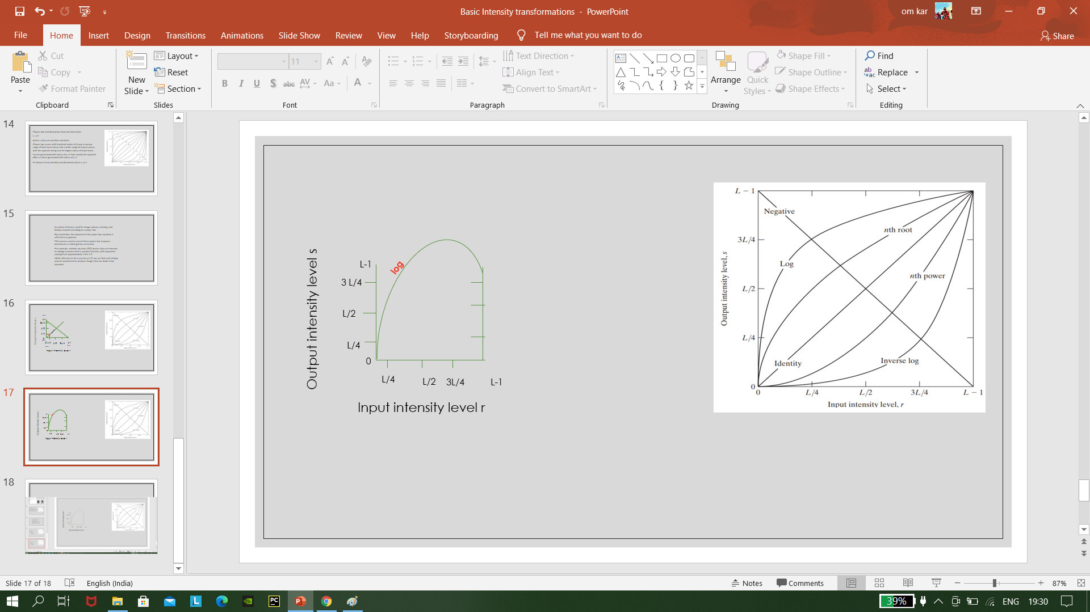
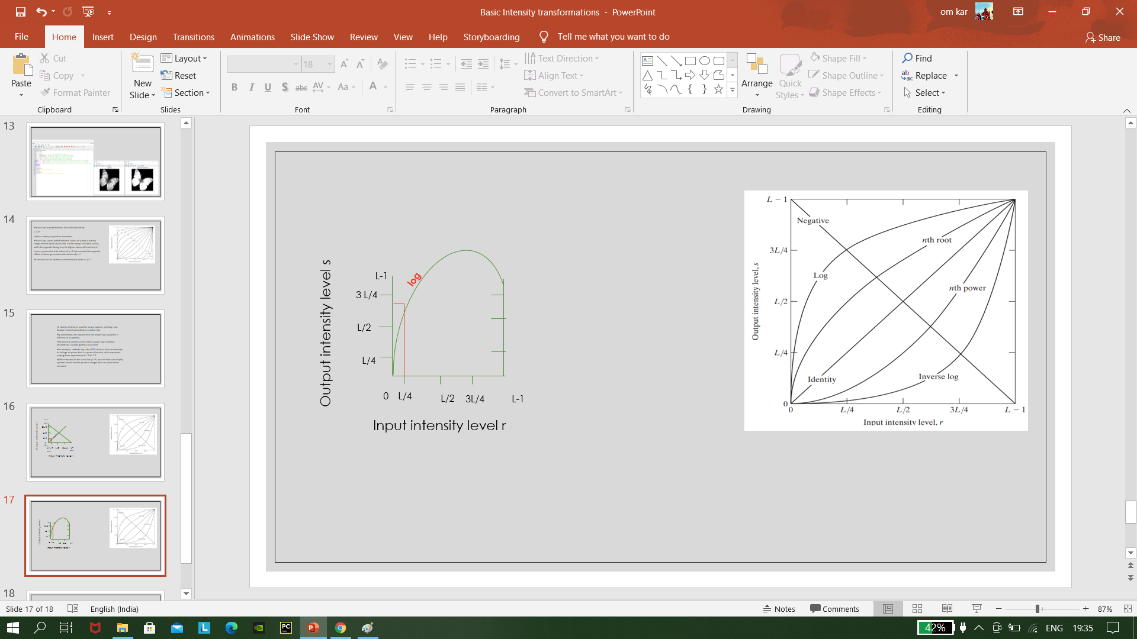
Log Transformations
The general form of the log transformation is-
s = c log(1 + r)
where c is a constant, and it is assumed that r≥0

Slide 14
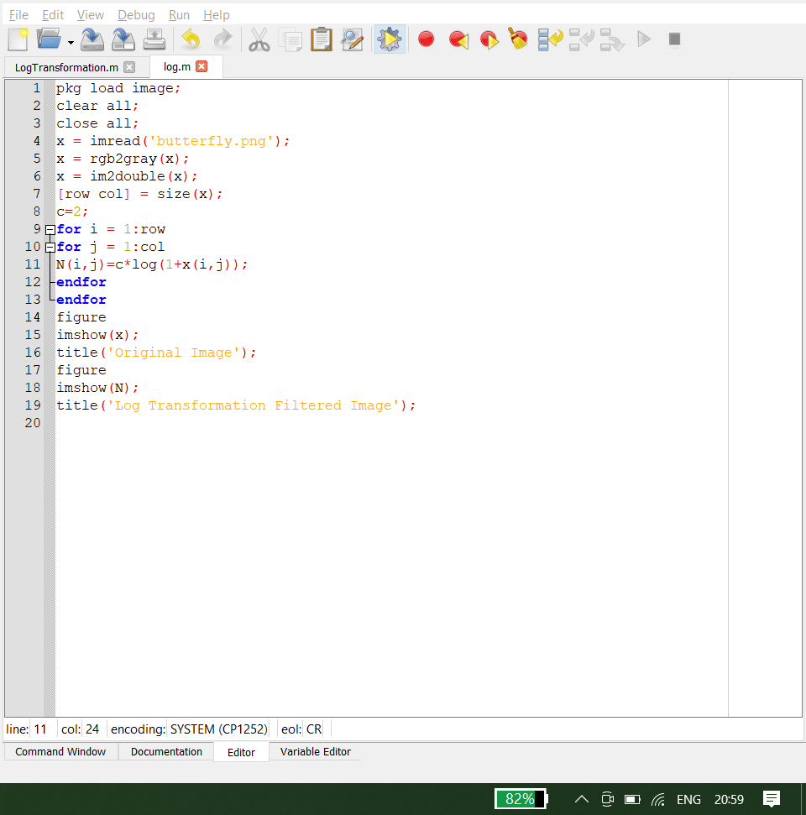
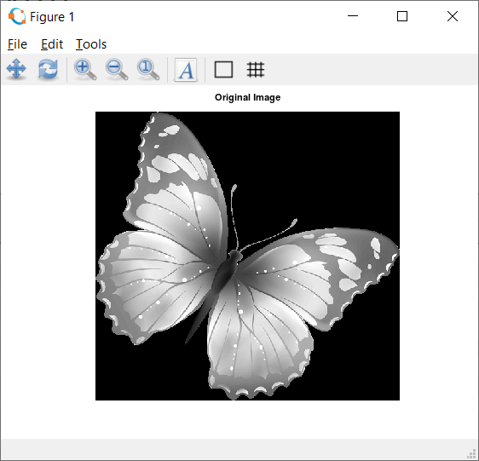
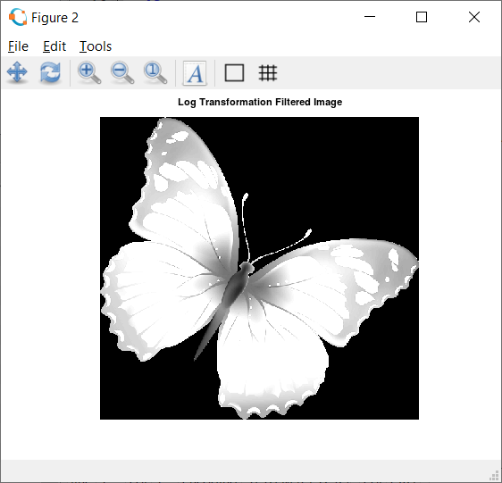
Application-:
the log transformation has been widely used in biomedical research to deal with the skewed data.

Slide 15
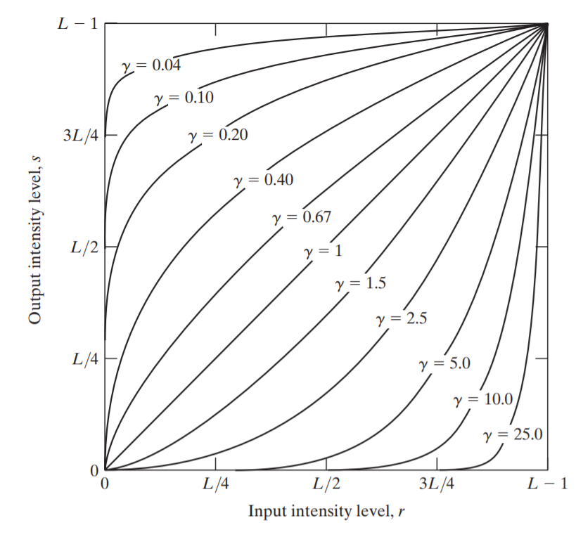
Power-law(Gamma) transformations have the basic form-
s = cr^{γ}
where c and γ are positive constants.
r>1=nth power
r<1=nth root
Power-law curves with fractional values of γ map a narrow range of dark input values into a wider range of output values, with the opposite being true for higher values of input levels.
curves generated with values of γ >1 have exactly the opposite effect as those generated with values of γ <1
It reduces to the identity transformation when c= γ=1

Slide 16

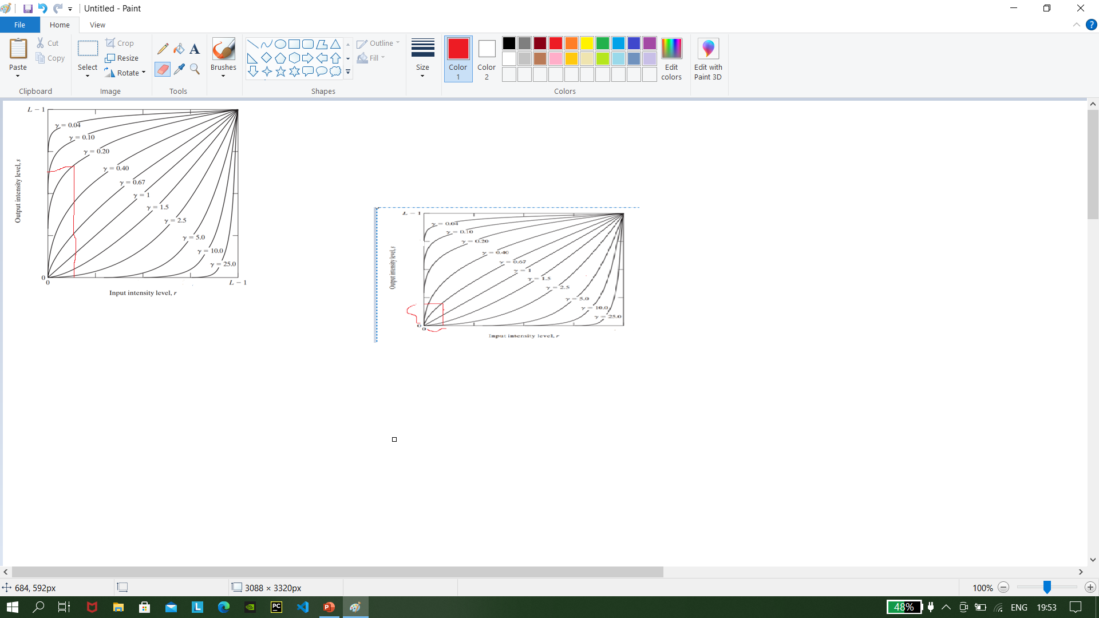
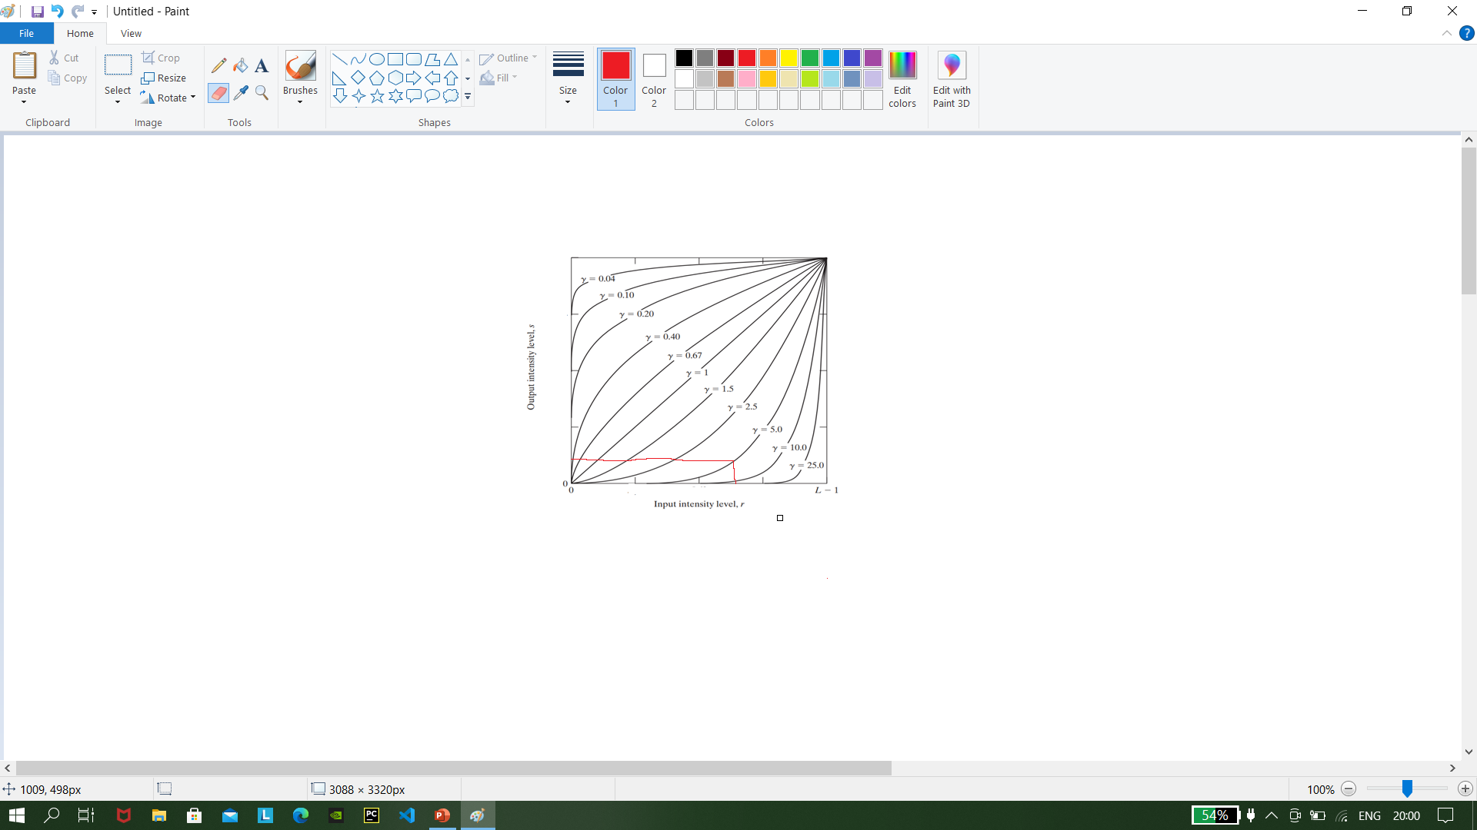
For example-: nth power
Nth root example
Less pixel values
High pixel values
Low pixel values
High pixel values

Slide 17
Power-law(Gamma) transformations have the basic form-
A variety of devices used for image capture, printing, and display respond according to a power law.
By convention, the exponent in the power-law equation is referred to as gamma,
The process used to correct these power-law response phenomena is called gamma correction.
For example, cathode ray tube (CRT) devices have an intensity-to-voltage response that is a power function, with exponents varying from approximately 1.8 to 2.5
With reference to the curve for γ=2.5, we see that such display systems would tend to produce images that are darker than intended

Slide 18
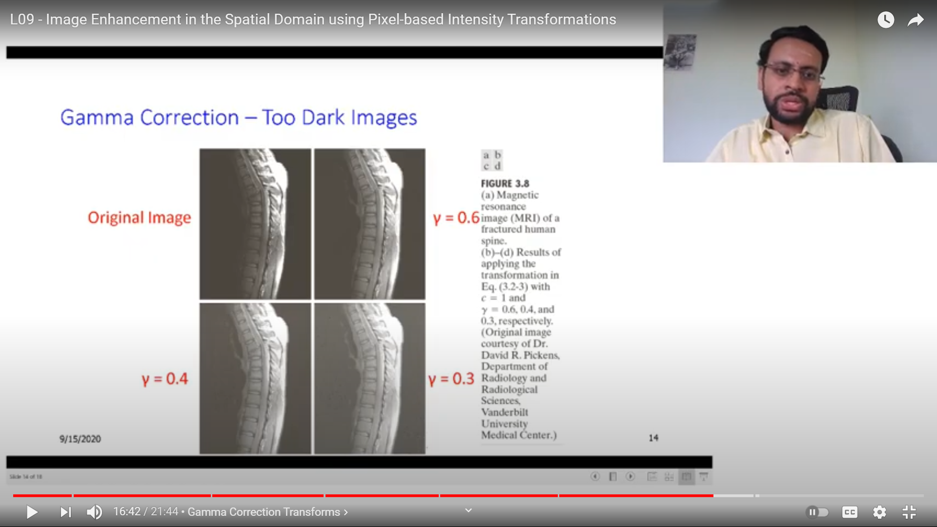
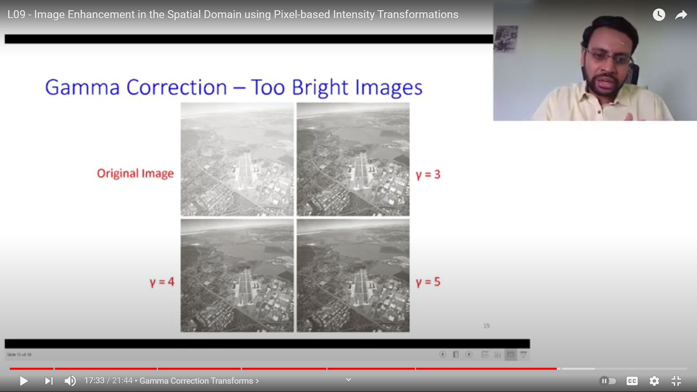
Gamma Correction

Slide 19
Thank you……..

